Slide 1


CS 153: Concepts of Compiler Design August 27 Class Meeting
Department of Computer Science San Jose State University Fall 2020 Instructor: Ron Mak
www.cs.sjsu.edu/~mak

Slide 2
Teams?

Slide 3
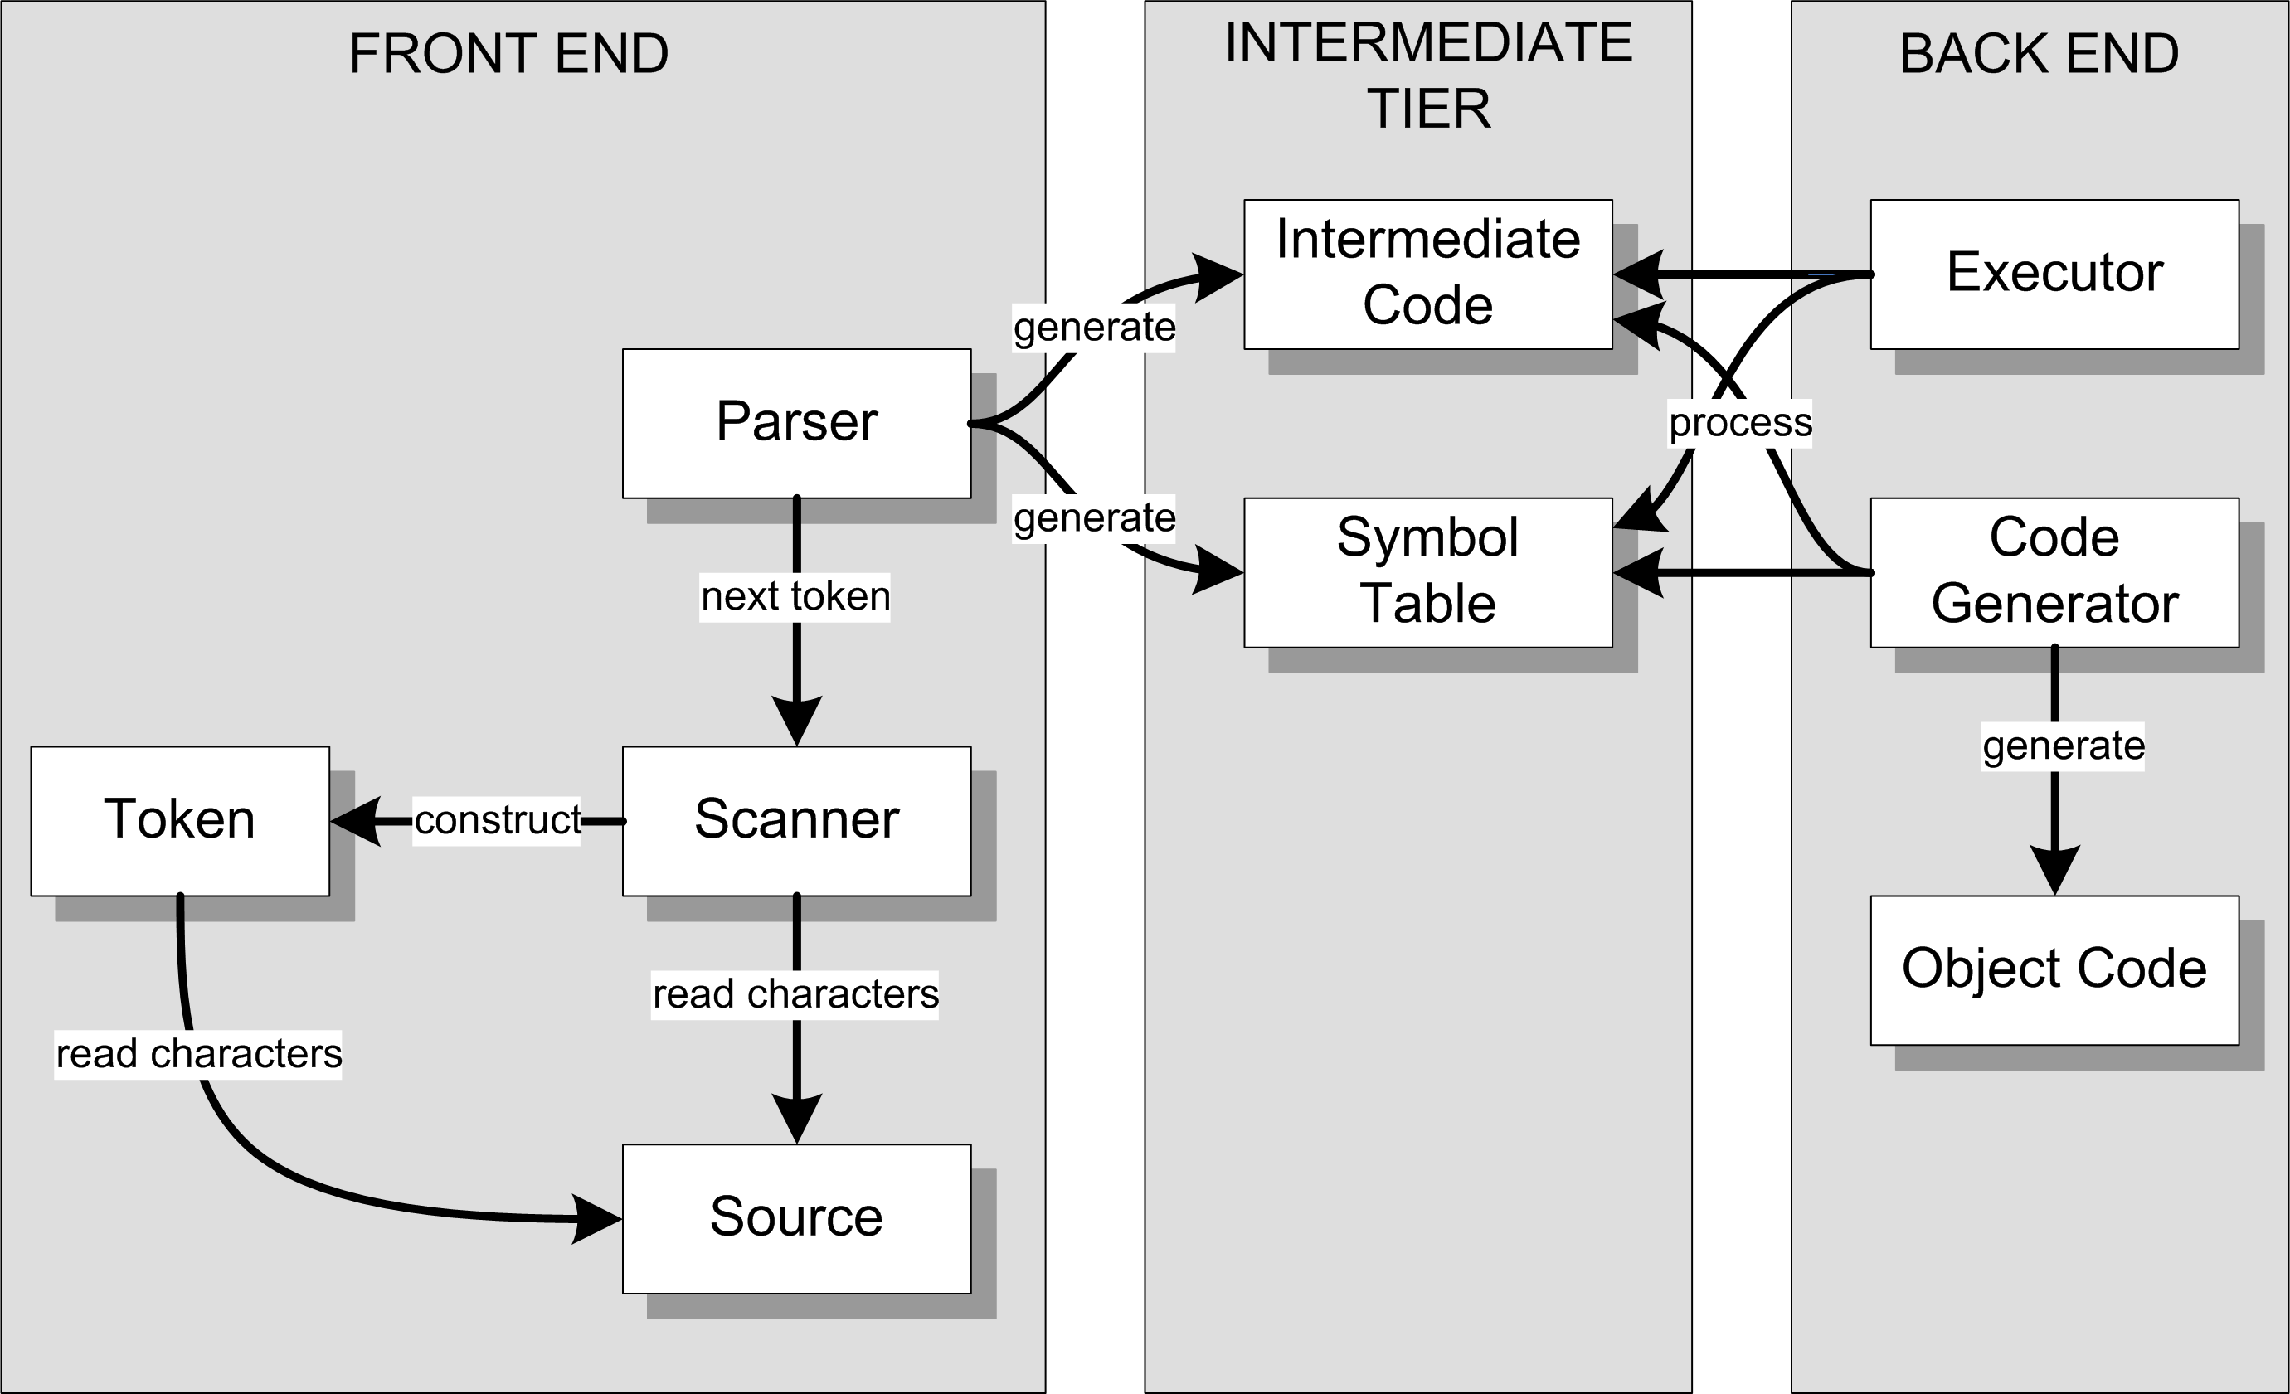
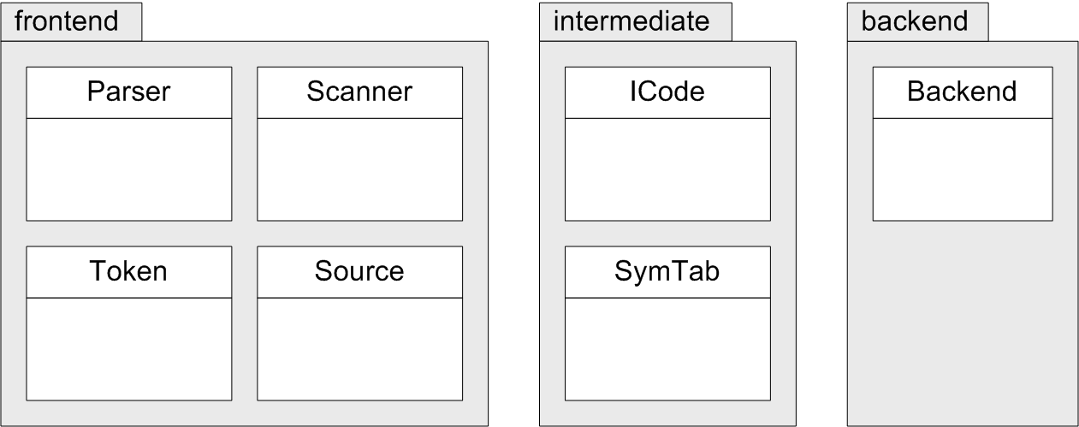
Three Java Packages
FROM:
TO:

Slide 4
Test the Scanner
Simple.java
main()
testScanner()
Source.java
currentChar()
nextChar()
Scanner.java
nextToken()
package frontend
Keep track of the current input character
and read the next character upon demand.
The scanner extracts the first character
of the next token. That first character
determines what type of token is next.

Slide 5
Test the Scanner, cont’d
Token.java
reservedWords table
word()
identifier
reserved word
number()
integer
real
string()
specialSymbol()
Distinguishes reserved words
from identifiers.
Each of these static Token member
functions is called by the scanner
to create a token of the appropriate
type and to extract the remaining
characters of the token.
package frontend

Slide 6
Assignment #2: Scanner
Make the scanner more complete by adding the following Pascal tokens:
Reserved words:
DIV MOD AND OR
CONST TYPE VAR PROCEDURE FUNCTION
WHILE DO FOR TO DOWNTO IF THEN ELSE CASE OF
Special symbols:
<= > <= <> .. ' [ ]
Pascal is not case-sensitive.
BEGIN begin Begin BeGiN
are all the same reserved word!

Slide 7
Assignment #2, cont’d
Test your scanner with this test file Newton.txt :
PROGRAM Newton;
BEGIN
writeln(' n Square root');
writeln('----------------');
FOR n := 1 TO 20 DO BEGIN
write(n:2);
root := n;
prev := root;
diff := 99999;
WHILE diff > 0.000001 DO BEGIN
root := (n/root + root)/2;
diff := prev - root;
prev := root;
END;
writeln(root:14:6)
END
END.

Slide 8
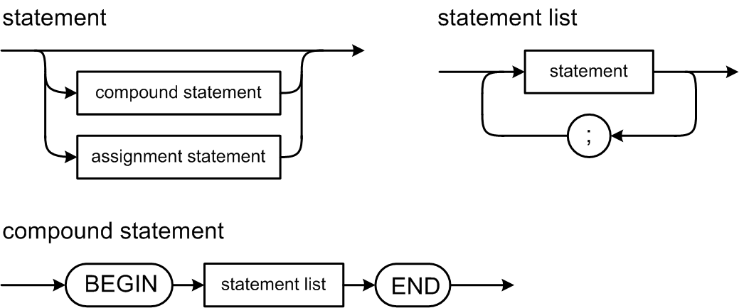
Pascal Statement Syntax Diagrams

Slide 9
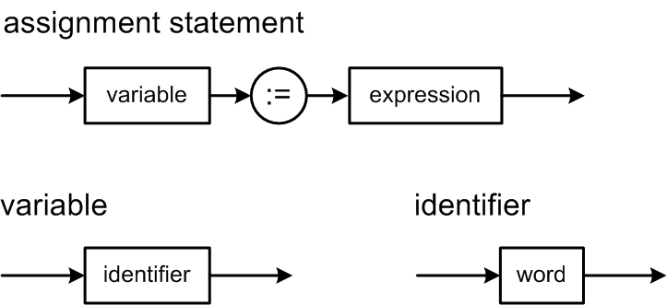
Pascal Statement Syntax Diagrams, cont’d
For now,
greatly simplified!

Slide 10
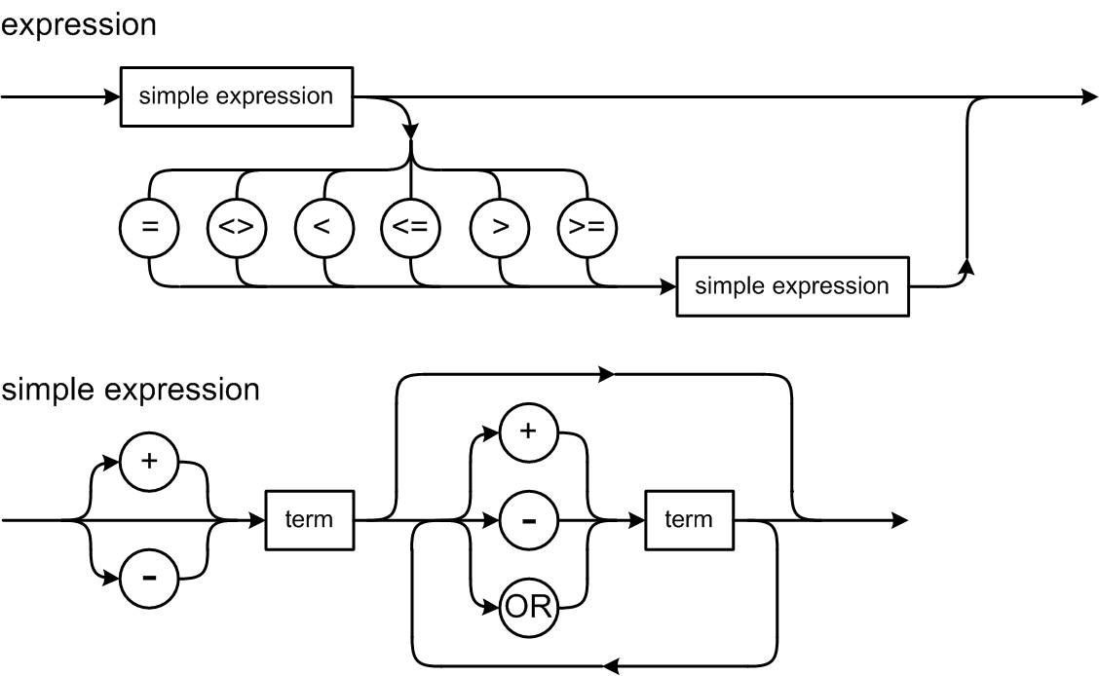
Pascal Expression Syntax Diagrams

Slide 11
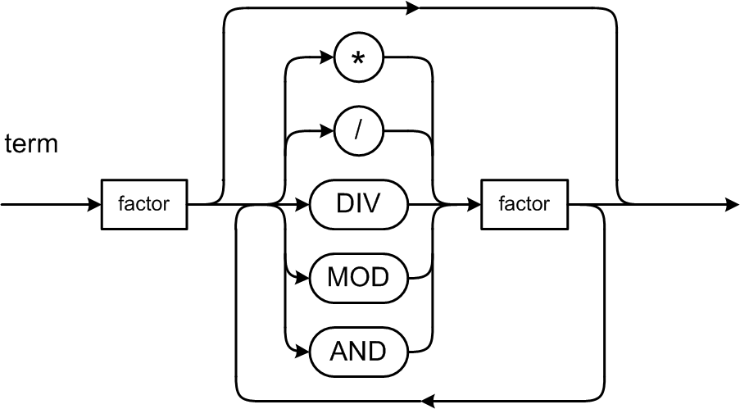
Expression Syntax Diagrams, cont’d

Slide 12
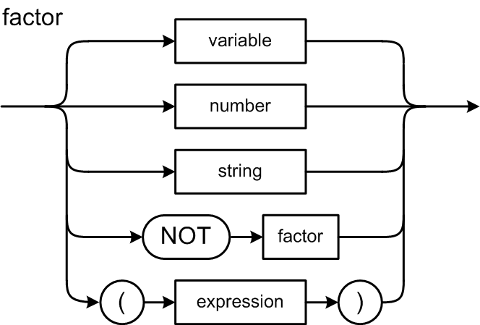
Expression Syntax Diagrams, cont’d

Slide 13
Pascal’s Operator Precedence Rules
Level | Operators
1 (factor: highest) | NOT
2 (term) | multiplicative: * / DIV MOD AND
3 (simple expression) | additive: + - OR
4 (expression: lowest) | relational: = <> < <= > >=
If there are no parentheses:
Higher level operators execute before the lower level ones.
Operators at the same level execute from left to right.
Because the factor syntax diagram defines parenthesized expressions, parenthesized expressions always execute first, from the most deeply nested outwards.

Slide 14
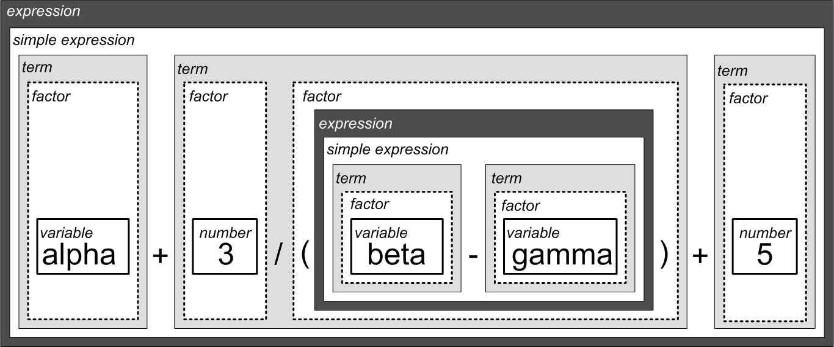
Example Decomposition
alpha + 3/(beta – gamma) + 5

Slide 15
Pascal Control Statements
Looping statements
REPEAT UNTIL
WHILE DO
FOR TO
FOR DOWNTO
Conditional statements
IF THEN
IF THEN ELSE
CASE OF

Slide 16
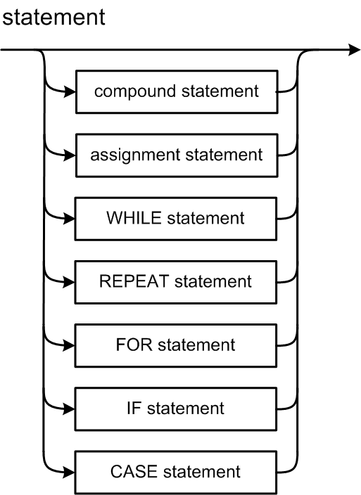
Statement Syntax Diagram

Slide 17
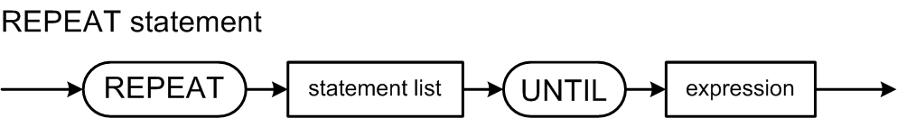
REPEAT Statement Syntax Diagram

Slide 18
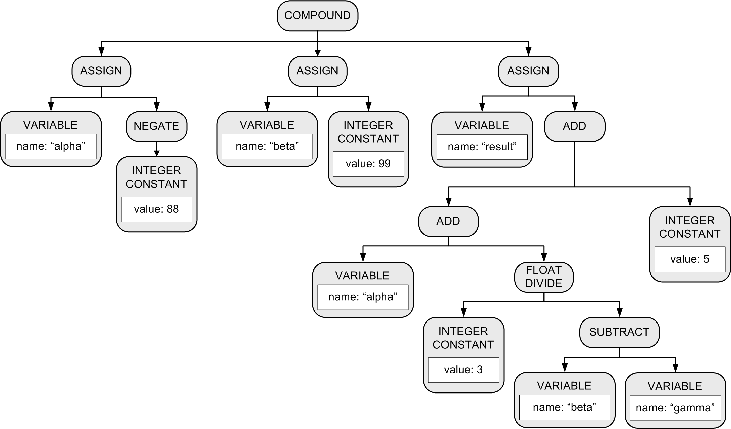
Parse Tree: Conceptual Design
More accurately called an
abstract syntax tree (AST).
BEGIN
alpha := -88;
beta := 99;
result := alpha + 3/(beta – gamma) + 5
END

Slide 19
Parse Tree: Basic Tree Operations
Create a new node.
Create a copy of a node.
Set and get the root node of a parse tree.
Set and get an attribute value in a node.
Add a child node to a node.
Get the list of a node’s child nodes.
Get a node’s parent node.

Slide 20
Test the Parser
Parser.java
parseProgram()
parseStatement()
parseAssignmentStatement()
parseCompoundStatement()
parseRepeatStatement()
parseWriteStatement()
parseWritelnStatement()
parseExpression()
parseSimpleExpression()
parseTerm()
parseFactor()
parseVariable()
parseIntegerConstant()
parseRealConstant()
parseStringConstant()
package frontend
Many individual parser
member functions!

Slide 21
Building a Parse Tree
Each parse*() member function builds a new subtree and returns new the subtree’s root node.
The caller of the parse*() function adopts the new subtree’s root node as a child of the subtree that the caller itself is building.
The caller then returns the root node of the subtree that it built to its caller.
This process continues until the entire source has been parsed and we have the entire parse tree.

Slide 22

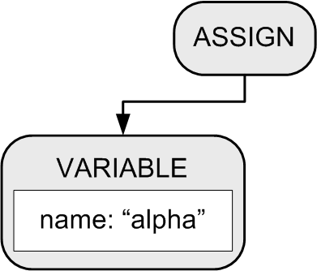
Building a Parse Tree
Example:
BEGIN
alpha := 10;
beta := 20
END
Function parseCompoundStatement() method creates a COMPOUND node.
2. Function parseAssignmentStatement() creates an ASSIGN node and a VARIABLE node, which the ASSIGN node adopts as its first child.

Slide 23
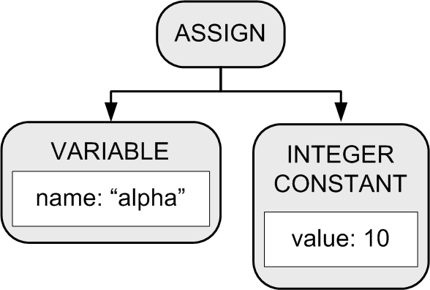
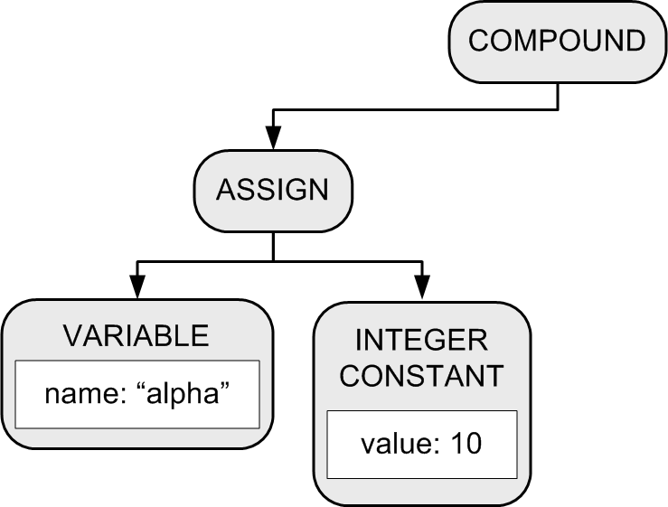
Building a Parse Tree
3. Function parseExpression() creates an INTEGER CONSTANT node which the ASSIGN node adopts as its second child.
BEGIN
alpha := 10;
beta := 20
END
4. The COMPOUND node adopts the ASSIGN node as its first child.

Slide 24
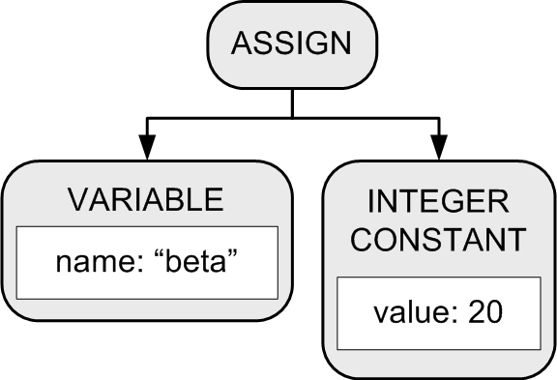
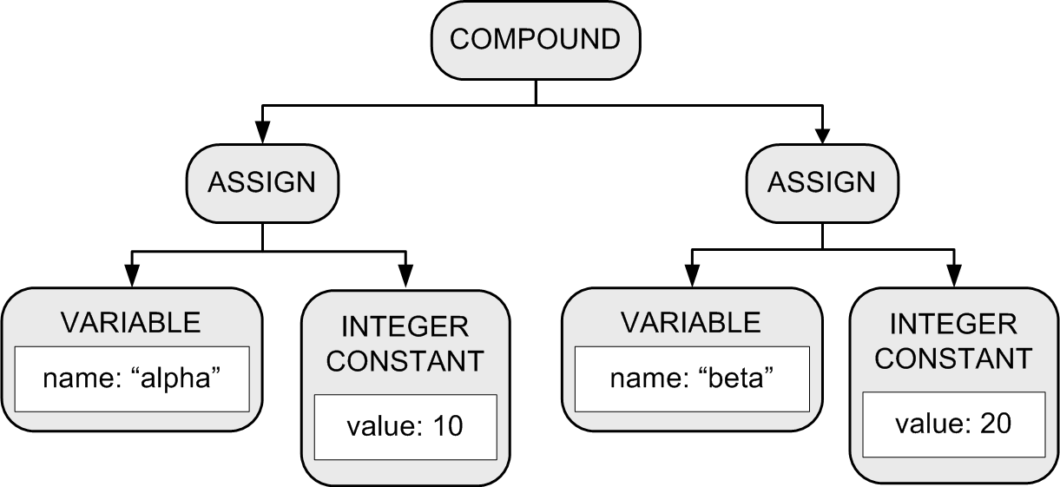
Building a Parse Tree
Another set of calls to functions parseAssignmentStatement() and parsExpression() builds another assignment statement subtree.
6. The COMPOUND node
adopts the subtree
as its second child.
BEGIN
alpha := 10;
beta := 20
END

Slide 25
Parse Tree Node
Node.java
adopt()
package intermediate

Slide 26
Types of Parse Tree Nodes
Node.java
public enum NodeType
{
PROGRAM, COMPOUND, ASSIGN, LOOP, TEST, WRITE, WRITELN,
ADD, SUBTRACT, MULTIPLY, DIVIDE, EQ, LT,
VARIABLE, INTEGER_CONSTANT, REAL_CONSTANT, STRING_CONSTANT
}

Slide 27
Printing Parse Trees
Utility class ParseTreePrinter prints parse trees.
Prints in an XML format.
package intermediate
<COMPOUND line="11">
<ASSIGN line="12">
<VARIABLE id="alpha" level="0" />
<INTEGER_CONSTANT value="10" />
</ASSIGN>
<ASSIGN line="13">
<VARIABLE id="beta" level="0" />
<INTEGER_CONSTANT value="20" />
</ASSIGN>
</COMPOUND>
Demo

Slide 28
The Symbol Table: Basic Concepts
Purpose
To store information about certain tokens during the translation process (i.e., parsing and scanning)
What information to store?
Anything that’s useful!
For an identifier:
name
data type
kind (variable name, type name, function name, etc.)

Slide 29
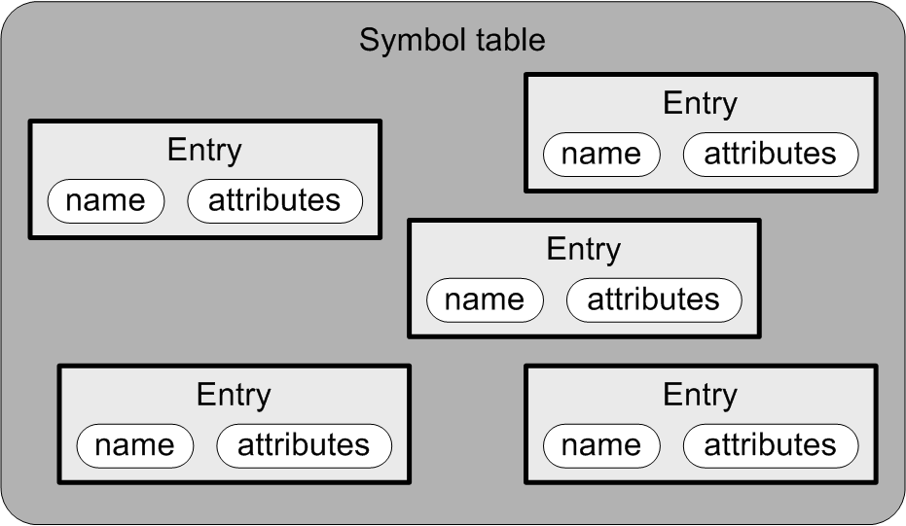
The Symbol Table: Conceptual Design
Goal: The symbol table
should be source language
independent.
Each entry in the symbol table has
a name
attributes

Slide 30
The Symbol Table: Basic Operations
Enter new information.
Look up existing information.
Update existing information.
The parser performs these operations whenever it gets an identifier token from the scanner.

Slide 31
What Needs a Symbol Table?
A Pascal program
Identifiers for constant, type, variable, procedure, and function names.
A Pascal procedure or function
Identifiers for constant, type, variable, procedure, and function names.
Identifiers for formal parameter names.
A Pascal record type
Identifiers for field names.

